Slide 1
A Presentation on Household Smoke Pollution
PRESENTED BY:
070/BME/647 - Sushma Thapa

Slide 2
3.5 Household Smoke Pollution
The forgotten 3 BILLION

Slide 3
Commonly used solid fuels
Wood
Crop waste
Charcoal
Coal
Dung
4.3 Million people a year!
KILLS

Slide 4
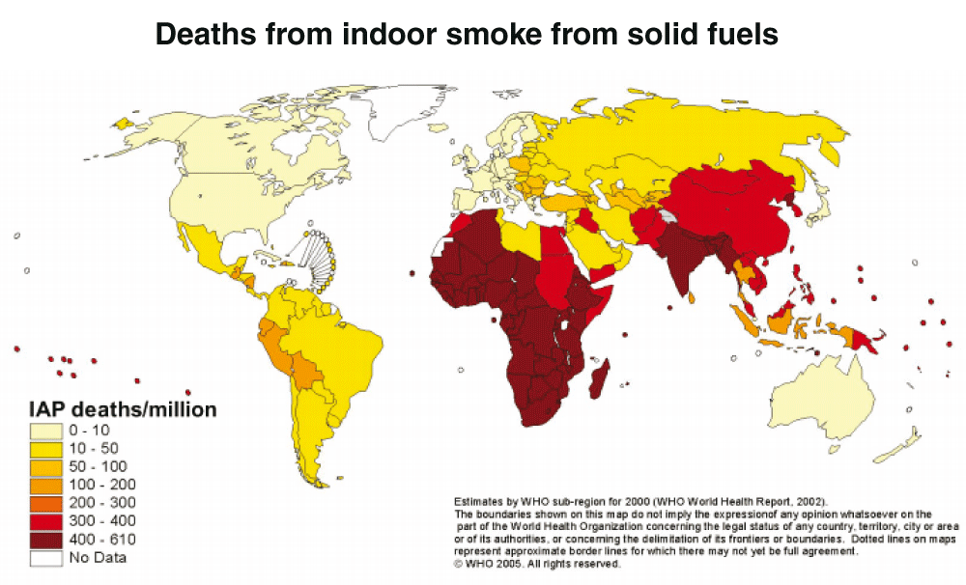

Slide 5
Possible Solutions
Control at Source:
a. Improved cooking devices
Improved biomass stoves without flues
Improved stoves with flues attached
Alternative fuel cooker combinations
Briquettes and pellets
Charcoal
Liquid petroleum gas (LPG), biogas, producer gas
Solar cookers (thermal)
Other low smoke fuels (eg. Methanol, ethanol)
Electricity

Slide 6
Possible Solutions
Reduced need for fire
Retained heat cooker, pressure cooker
Efficient housing design and construction
Solar water heating (keeping water in sunlight)
2. Control at living environment:
Improved ventilation
Hoods/fireplaces/chimneys built into the structure of house
Windows/ventilation holes/eaves spaces
Kitchen design and placement of the stove
Kitchen separate from house reduces exposure of family
Stove at waist height reduces direct exposure of the cook leaning over fire

Slide 7
Possible Solutions
User Behavior:
Reduced exposure through operation of source
Fuel drying
Use of pot lids to conserve heat
Food preparation to reduce cooking time (eg. Soaking beans)
Good maintenance of stoves, chimneys and other appliances
b. Reduced exposure by avoiding smoke
Keeping children away from smoke (eg. In another room)

Slide 8
References
https://www.ncbi.nlm.nih.gov/pmc/articles/PMC1892127/
http://www.who.int/mediacentre/factsheets/fs292/en/
http://www.who.int/indoorair/en/

Slide 9
THANK YOU!!

